Slide 1
Completing an IRB Application

Slide 2
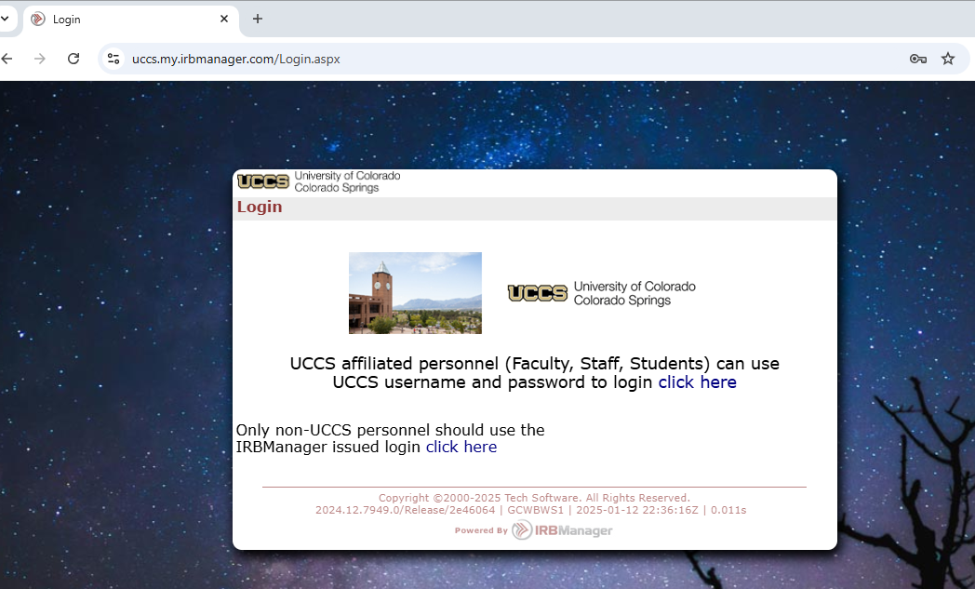
Open IRBManager
IRB Manager can be accessed at https://uccs.my.irbmanager.com/Login.aspx
Login using your normal UCCS credentials where it says “Click Here”

Slide 3
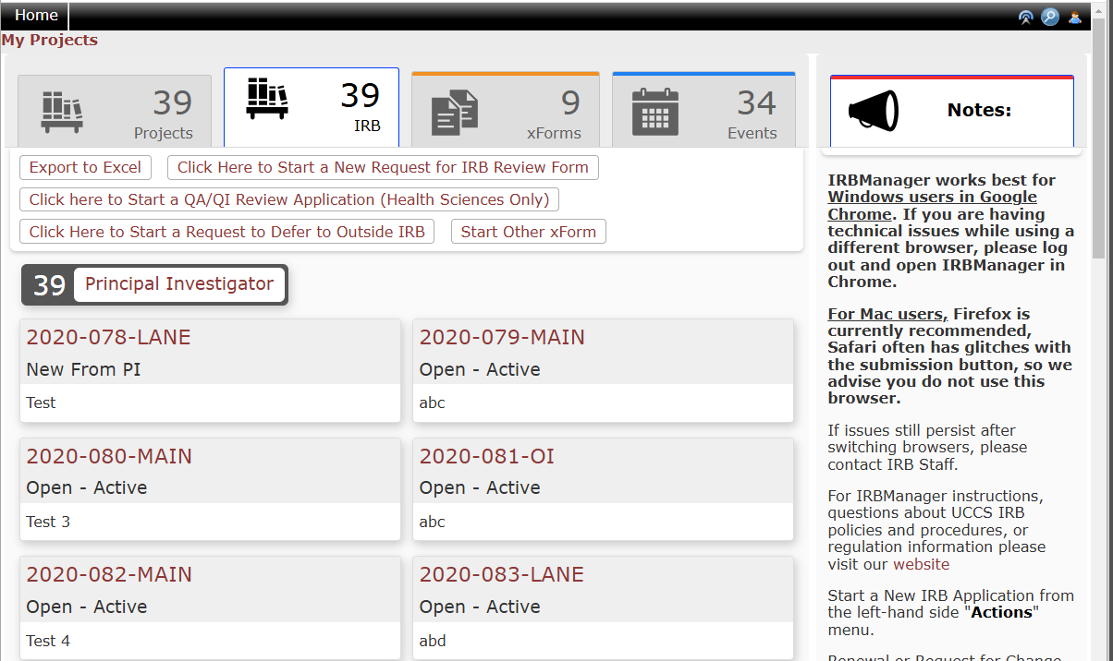
IRBManager Dashboard
You will land on the IRB page of your dashboard when you login.
From here you can start an IRB application, review previously approved projects, communicate with the IRB, and track any forms in progress.
Click on the button to “Start a New Request for IRB Review”.

Slide 4
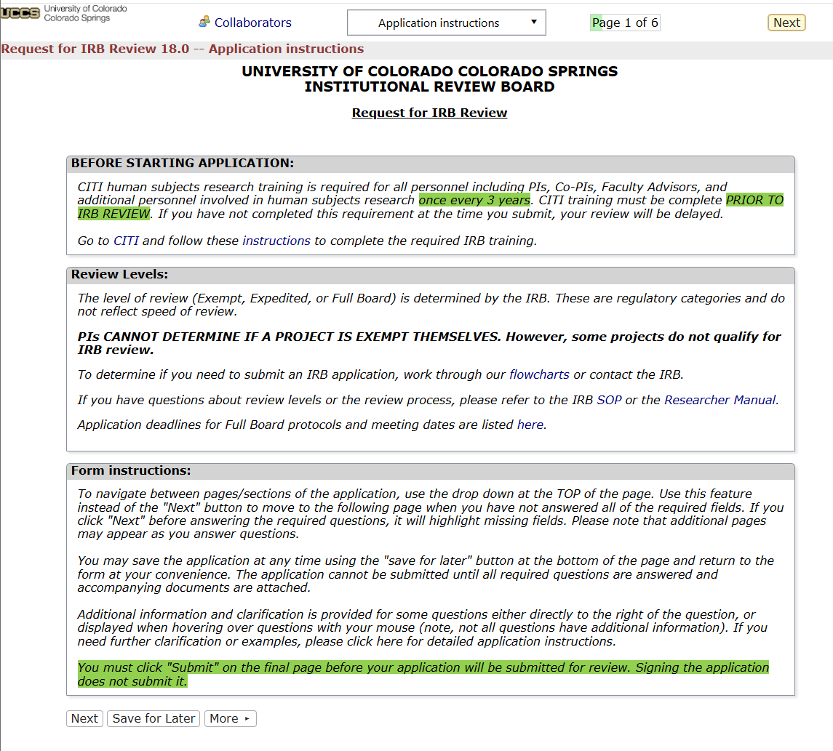
Completing the application
Important items for successfully completing your IRB application:
CITI training must be completed before your application can be approved. If you have not completed it, please use the link in the application to do so.
The application should save your progress as you go. You can also click “Save for Later” and exit at any time.
The application will add pages and questions based on your answers. Please answer all questions to the best of your ability.
If you get stuck at any point during your application, please email IRB@uccs.edu.

Slide 5
Completing the application cont.
Please answer all questions on the application.
If you are a student, you will need a Faculty Advisor to review and sign off on the project before IRB review. You will add them on the “Study Personnel” page. Student and outside personnel can be added here as well. All personnel should have CITI training before working on a project.

Slide 6
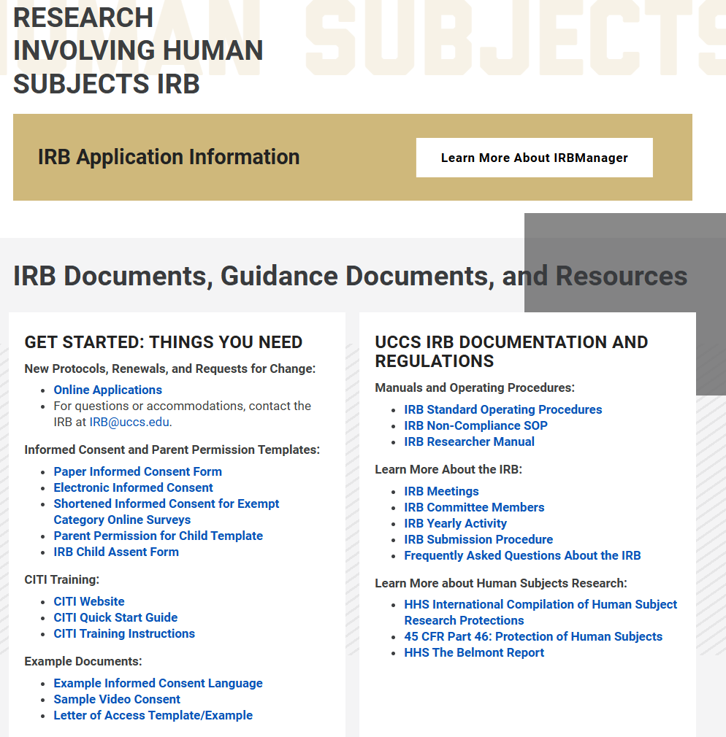
Tips for a successful application
Make sure you have created all your study documents before you start your application.
Templates can be found on the IRB website https://osp.uccs.edu/research-compliance/research-involving-human-subject-irb
Use clear and concise language. Avoid jargon, highly technical language, and citations.
Explain the application where someone outside your discipline can understand.

Slide 7
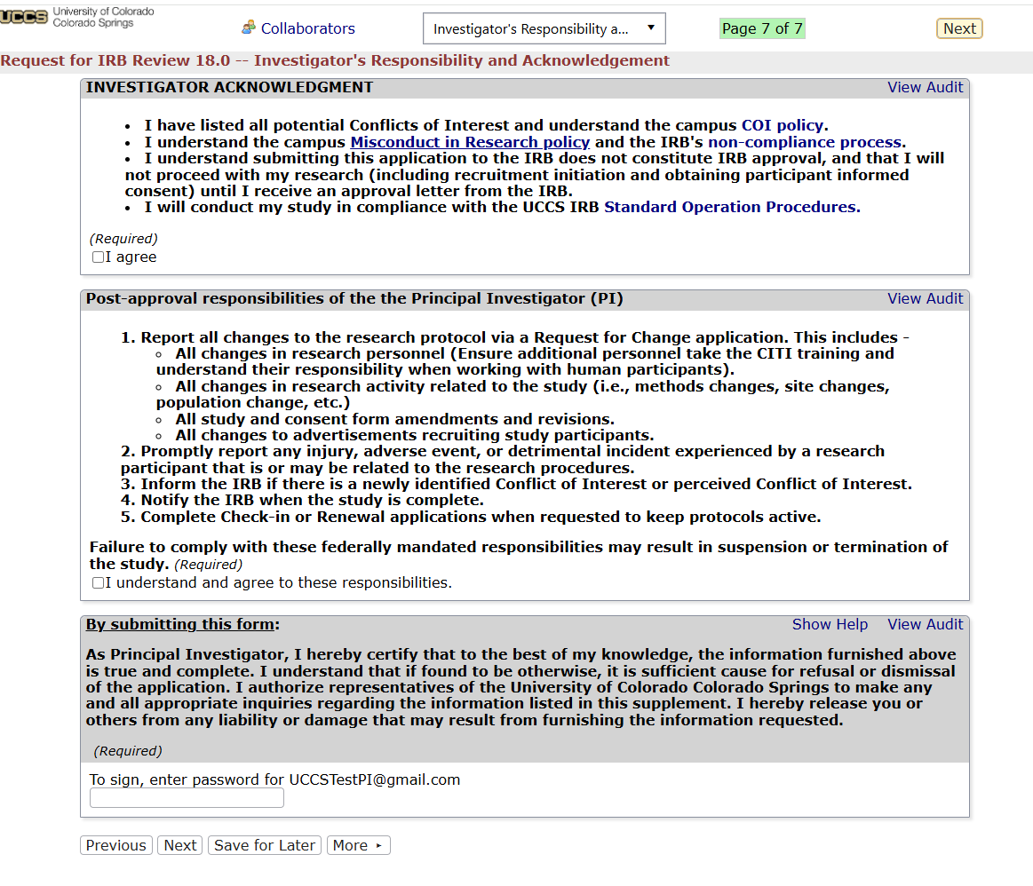
Tips for a successful application
Make sure to both sign AND submit your form.
On the investigator’s responsibilities page, you will read and agree to your responsibilities as a PI.
At the bottom of this page, you will digitally sign with your credentials.
It is important to click “Next” at either the bottom or the top of the page and go to the final page.

Slide 8
**Your form is not completed and submitted to the IRB until you click the submit button and receive the confirmation page**

Slide 9
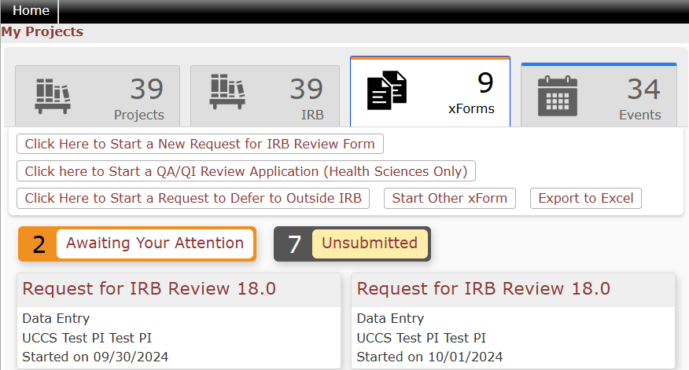
After submission
Once your protocol is submitted, it may take up to 10 business days to be reviewed depending on the time of the semester you submit your review and the type of the review. Feel free to check in on the progress of your review at anytime. You can track the progress of your application from your dashboard using the “xForms” tab.

Slide 10
Revisions
Some protocols might require revisions before being approved. You will be notified via email that your submission requires edits. Use the link in the email or your dashboard to access the application.
The application will open and look like the initial application. You can revise any questions or areas you were asked to by the reviewer.
If you have questions about the revisions requested, contact the IRB or your reviewer.

Slide 11
Approvals
Once your protocol is approved, you will receive notification via email with a PDF approval letter, stamped consent form (if applicable), and stamped flyer (if applicable).
You can start your research at this point.
If you need to make any changes to the research design, documents, etc. after the initial approval, you will need to complete a Request for Change application.

Slide 12
Please direct any questions, comments, issues, feedback, etc. to IRB@uccs.edu or contact the Human Subjects Research Compliance Director

