Slide 1
Completing a Request for Change Application

Slide 2
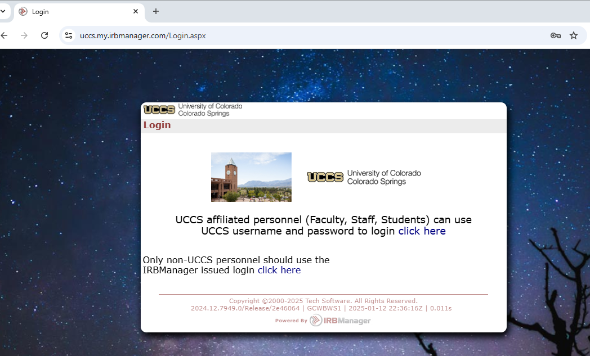
Open IRBManager
IRB Manager can be accessed at https://uccs.my.irbmanager.com/Login.aspx
Login using your normal UCCS credentials where it says “Click Here”

Slide 3
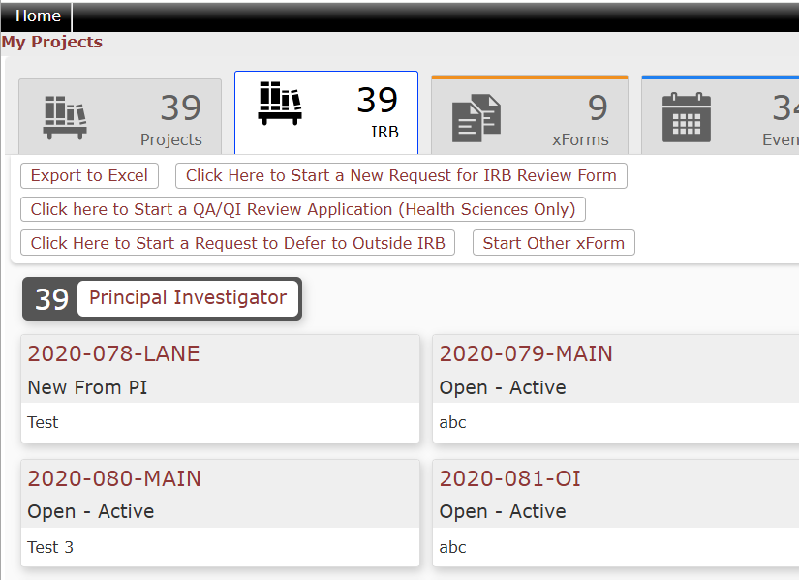
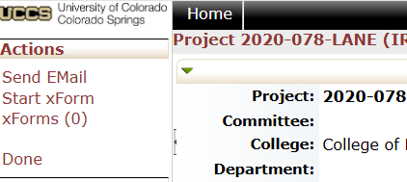
Starting the ROC
From your dashboard, locate the protocol you wish to file an ROC for and click the hyperlink.
Locate “Start xForm” in the top left corner of the following page and click the link.

Slide 4
Choose the Request for Change application
Note- you can start other forms from this page as well, including the Unanticipated Event/Deviation form

Slide 5
Completing the ROC
Make sure to select all changes to the protocol and any associated documents. Most of the options will add additional questions asking for more information.
Answer all the questions on the brief application.
Make sure you upload any updated documents (consent forms, questionnaires, surveys, etc.)

Slide 6
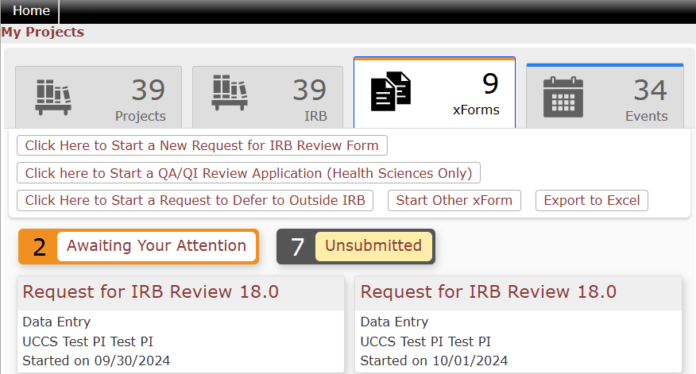
After submission
Once your protocol is submitted, it may take up to 10 business days to be reviewed depending on the time of the semester you submit your review and the type of the review. Feel free to check in on the progress of your review at any time. You can track the progress of your application from your dashboard using the “xForms” tab.

Slide 7
Revisions
Some protocols might require revisions before being approved. You will be notified via email that your submission requires edits. Use the link in the email or your dashboard to access the application.
The application will open and look like the initial application. You can revise any questions or areas you were asked to by the reviewer.
If you have questions about the revisions requested, contact the IRB or your reviewer.

Slide 8
Approvals
Once your protocol is approved, you will receive notification via email with a PDF approval letter, stamped consent form (if applicable), and stamped flyer (if applicable).
You can start your research at this point.
If you need to make any changes to the research design, documents, etc. after the approval, you will need to complete an additional Request for Change application.

Slide 9
Please direct any questions, comments, issues, feedback, etc. to IRB@uccs.edu or contact the Human Subjects Research Compliance Director

